Slide 1
Gas Power TCoE landscape – Capgemini presence
Scope of work
Manual Testing
Automation Testing
API Testing
ETL Testing
DevSecOps
Performance Testing
Application Technology Stack
SAP
Oracle ERP Apps
Web Applications (Products)
Data Lake
Ariba
OTM
SFDC
ERP+ Programs
100% PMx Regression
New Units
Alpha MGPP
Test Management for PMx and Alpha MGPP
Charlie Exit
CPQ
Power Customer Portal
PMx
ICS
CPL
RealTrack
PMx ALM
OTM
Ariba
DIB
Redwood
PMx New Units
PLP
BW HANA Reports
DLI
SmartShop
Alpha Parts
MGPP
PnL360
EventVision
GTM
SPEC

Slide 2













Proposed Operating Model
Governance
Apps
In-Scope
CONTRACTUAL SERVICES
AMP
Catalog
MyFleet
Confirm
Escalation
BLD
Prism +
Flex PODs
Horizontal Shred Team
Proven Industry Leading Tools
Accelerators &
Frameworks
Proven Capgemini tools
Gen-X
50% increase in deployment speed
Digital Cloud Platform
Gen-AI
Cloud Acceleration
CIF - Integration
DevOps, CI/CD, SAST, DAST
Cloud Native Microservices, security
Development, Coding, Documentation
Cloud Formation, Automation, Cost Optimization
Regulatory Compliances
Collaboration
Cross Functional Specialized Services
Build & Implementation
Quality Engineering
Testing CoE
Security
Integration
DevOps
Process Automation
GE Vernova Academy
Architecture
Regulatory Compliances
Infrastructure and Platform Engineering
Shared
Capgemini
GE Vernova

Slide 3




Execution Approach
Company Confidential © Capgemini 2021. All rights reserved |
3

Slide 4
Our Solution approach
Security
Governance
Analysis & HL Design
Low Level Design
Build
CI / CD
DevOps
Deploy
Testing
Analysis & Design / Project Plan / Detailed Understanding of Current System / Target System Specifications
Build Target System through Agile / DevOps Approach
Hypercare
Approach
Functional Specifications
Features Documentation
Existing Data Model Transitions
Existing Machine Learning Model and mapping to Usecase
Reporting Requirement
User Mgmt Requirement
Scheduled Jobs
User Experience
Azure Cloud Infra, Application & DB Architecture & Services Identification with estimated setup cost
Approach
support Go Live
Develop Features and User Stories detailing with acceptance criteria to the specifications of the target system
Wireframes / UI Mockup for stories
Detailed DB Modeling and Creation of DB Objects
Low Level design for User Interface, Microservices & DB
OpenAI and NLP Design
UI Application Development & Testing
Microservice Development & Testing
CICD Automation
Data Cleanup and Scheduled Load to App DB
Validation of application against Legacy application
Knowledge Transition & User Training
Application & Documentation handover

Slide 5
Test Automation Approach - In progress
Environment Setup and Access
Planning
Design
Execution
Handover and
Continuous Improvement
Setup environment for SIT/UAT
HVR & FDL refresh for SIT/UAT
Pillar application readiness.
Data Conversion status
Data load into required applications(Alpha/EV)
Scope identification based on business needs & Countries
Prepare Day to day execution plan
Create Automation Strategy and Plan
Prepare Master Data and derive test data sets
Customize the Automation Framework and Libraries as required
Automate the identified test cases using UFT, WorkSoft.
Perform Dry run
Kickoff test execution based on project timelines and priorities
Execute automated test suites across different processes/modules, countries and Integrated applications.
Provide detailed reports and metrics to stakeholders, including defect trends, test coverage, and automation effectiveness
Create Closure Report and Recommendations
Sign off from the client
Deliverables
Deliverables
Deliverables
Deliverables
Deliverables
Environment/Applications access and Automation Tool setup is completed
Execution Schedule for entire SIT/UAT
Automated test scripts
Test result
Defect report
Closure Report and Recommendations
CG - Value proposition
CG - Value proposition
CG - Value proposition
CG - Value proposition
CG - Value proposition
Check for specified roles and responsibility access for all integrated applications
Can understand and implement the plan without any delays.
Capability to identify missing or Wrong data.
In-depth functional knowledge helps develop/Modify scripts faster.
Identify opportunities for automation for any repetitive tasks
Early defect identification
Proven experience in faster & Smother executions.
Reach out to specific functional owners for faster defect resolution.
Customized execution report according to business needs

Slide 6
Assumptions - Alpha
Estimates cover below process
Tx Parts (CS PO Parts, RFQ, Engg flow, Warranty and COQ)
Tx Core ( Parts, FieldCore, PMx, External Iproc )
CS/MMP ( Parts, FieldCore, Repairs, PMx, External Iproc)
Tx CMU (FieldCore, Repairs, PMx ( OSS/Performance), External Iproc)
APEX (LTL, IBS, CORA and Sabrix)
Parts ( So, WHS manual allocation, Delivery, OTM, Telnet Pick/Pack, OTM Ship/Conf, Export release)
FieldCore (Project, SO, Delivery, RRB Delivery, Cost allocation, Invoice, IDOC reprocess)
SAP Repairs(Assign repairs Shop, SO, Inbound & Outbound Delivery, Invoice, Send to IBS)
PMx (SO, delivery, RRB delivery, Cost allocation, Invoice, Send to IBS)
Charlie (CS Billing, MMP, PSP and T&M PROGRESS)
NEX ( Tx CMU Process outage)
EV (Tx Core, Tx Parts and CSA/MMP projects, FC PO, OSS PO, Performance PO, SO, PMx & Charlie Projects)
Automation team can support SIT/UAT for an estimate of 10 countries with 2 contracts for each country in SIT/UAT.
Third party application testing done as per business flow(E2E).
Scenarios identification-based User stories done by Business.
Modular/ Functional testing done by Business.
Finance validation, Cost validation done by Business.

Slide 7
Assumptions - Charlie
Estimate coverage of below processes
EV (EG0, IFF, Digital, Warranty projects, FC PO, Digital PO, SO)
FieldCore (Project, Cost allocation, Invoice, IDOC reprocessing)
Parts Alpha(Project ,PO , Alpha SO, Telnet Pick pack, Invoice, IBS)
Warranty(GTM to PPCH, GTM to P9S8, FC to PPCH and FC to P9S8)
Timecards(Cross company and Inter company time booking)
External Billing(External PO, GR,IR , Apex payment document)
SAP Repairs(Internal PO, SO, Repairs Fulfilment, Invoice, IBS)
Repairs Smart Package (GTM SO, Repairs SO, Invoice, IDOC reprocessing)
Release Strategy(PR, PO, Verify PR and PO release code)
Parts CCSO( Contract, Cross Company SO, Invoice)
NO ESN, MJE, RRB, ICRRB, Period Closing
APEX (LTL,TRAX C2C and FX, AP Reports ,AP Scripts)
Concur(Project allocation, Accrual, SAE)
IBS (All internal billing processes)
Automation testing team can support SIT/UAT for an estimate of 18 Company Codes per release.
Automation support is provided for SIT1, SIT2 and UAT testing.
Integrated application testing limited to EV, Alpha, Fiori, SAP Repairs, APEX, Concur, IBS.
SIT/UAT finalization done by Business Owners.
Scenarios identification-based User stories done by Business.
Charlie ERP testing, Finance validation, Cost validation done by Business.
Tx, CSA– 100% of the E2E process is automated and executed is being done through Automation.
Modular– Warranty, Parts Alpha, Repairs Smart Package, Parts CCSO, Release Strategy
Applications– EV, PMx, Alpha, Fiori, SAP Repairs, APEX, Concur, IBS
Enterprise Standard: Concur , IBS and APEX are 100% automated.
Configuration: Period opening scripts are run every month in Acceptance and Per-prod environments
Automation support is provided for SIT1, SIT2 and UAT testing.

Slide 8
ASSUMPTIONS – ECHO & NEW UNITS
Estimate coverage of below processes
APEX – LTL, Cora, Sabrix and IBS modular testing.
Fx Internal and External Single Request/Request Sets
IBS Validation – PO Validation in IBS
Clear Orbit – ERP to ClearOrbit integration scenarios
FI Periods – AP, AR, GL, PO and PS PA
Creation - PR, PO, Receipts, SO, Invoice creation.
Automation testing team can support SIT/UAT for an estimate of 8 countries per release.
Automation support is provided for SIT1, SIT2 and UAT testing.
SIT/UAT finalization done by Business Owners.
Scenarios identification-based User stories done by Business.
Charlie ERP testing, Finance validation, Cost validation done by Business.

Slide 9
Execution Approach
Scope Identification
Automation Readiness
Automation Execution
Maintenance/ Continuous Improvement
Scope identification based on business needs & Countries.
Analyze & gather automation scope for functionalities, integrations and scenarios.
Identify performance testing scenarios.
Prepare automation schedule to align with release calendar.
Prepare Day to day execution plan.
Prepare Master Data and derive test data sets.
Validate configuration and Integration of pillar applications
Align automation tools and infrastructure.
Kickoff test execution based on project timelines and priorities.
Execute automated test suites across different processes/modules, countries and Integrated applications.
Monitor test execution progress, analyze test logs, investigate test failures and raise defects accordingly
Collaborate with IT team and Business to investigate and resolve identified defects.
Provide detailed reports and metrics to stakeholders, including defect trends, test coverage, and automation effectiveness.
Identify opportunities for automation for any repetitive tasks.
Regularly review and refactor test code to improve maintainability, scalability, and performance.

Slide 10
Tool strategy
Capgemini Owning
GE Vernova Owning
Purchase WorkSoft & UFT tools license.
Migration of Automation scripts to Capgemini servers.
Environment setup readyness for Automation
Testing timelines might delay due to Readiness of Automation setup As Migration is a time taking process
Decommission of TCoE AWS Servers & VMs.
Integration with existing systems may require additional effort and customization.
Existing license can be used.
Scripts can be used dirrectly
Required in-house expertise for maintenance of automation tools and environment setup
Building and maintaining an automation infrastructure requires skilled personnel, time, and ongoing investment.
Existing license and Setup can be used.

Slide 11
Alm Administration - In progress
ALM Access
Preparation
Plan
Execution
Handover and
Continuous Improvement
Raising request for New Users
User Creation in ALM
Assign specified roles
Loading User Stories/Requirements
Crating Cycle & Release
Loading Test cases into test Plan
Tying all test cases to their respective User stories.
Create Status Report, Defect reports
Create SIT/UAT place holder in Test Lab
Loading test cases into Test Lab
Assign test cases to respective tester
Prepare execution plan and update in Test Lab
Sharing the execution plan with business.
Tracking execution status
Handling day status call
Defects Discussion
Sharing SIT/UAT progress report reports with Business.
Conducting defect triage calls
Customization of fields if required.
Improvement plan based on
Handover the SIT/UAT reports to the business.
Create Closure Report and Recommendations
Sign off from the client
Deliverables
Application Access
Environment access and Automation Tool setup is completed
Deliverables
Deliverables
Deliverables
Deliverables
Automation approach and strategy
List of automatable Regression Test cases
A highly reusable component-based framework
Automated test scripts
Test result
Defect report
Run book
Closure Report and Recommendations
Value proportion

Slide 12
Test Automation Approach
Environment Setup and Access
Planning and KT
Design
Execution
Handover and
Continuous Improvement
EventVision Application access request
Setup environment for Test Automation
Installation of Robot Framework, Python and other Automation Tool
Create Automation Strategy and Plan
KT and scope understanding with existing stakeholders
Identification of the Regression Test cases as candidates for Test Automation
Provision of Test data
Customize the Automation Framework and Libraries as required
Automate the identified test cases using Robot framework, Python
Perform Dry run
Execute the scripts
Defect logging, if any in defect management tool
Email notification on script failure and execution completion
Review of completed scripts and execution result with functional SMEs and sign off
Improvement plan based on captured automation reports
Handover of Run book
Create Closure Report and Recommendations
Sign off from the client
Deliverables
Deliverables
Deliverables
Deliverables
Deliverables
Application Access
Environment access and Automation Tool setup is completed
Automation approach and strategy
List of automatable Regression Test cases
A highly reusable component-based framework
Automated test scripts
Test result
Defect report
Run book
Closure Report and Recommendations

Slide 13
Regression Automation Approach
A systematic approach to handling the automation of regression suite is as described below
Minor Enhancement
Tickets
1 0 1 1
0 0 1 1 1 0 1
0 1 0 0 1 1 0 1
1 0 1 0 1 1 0 0
1 0 1 1
Test Cases Repository
Build & Maintain test scripts
Test Script Repository
Prioritize Test Cases
Automation Feasibility Validation
Manual Test Cases
Test Case Walkthrough
Regression test suite
YES
Automated Test Scripts
Prioritization and updates of Test cases/Business Critical Processes
NO
Script Development & Dry Run
Tests Data
Test Script Sign-off
Test Execution
Automated Tests
Manual execution of Non-Automated Tests
Tests Results Data
(Pass / Fail)
Test Sign-Off
@
Report Issues & Raise Defects
Publish Test Results
Release Deployment
Test Log & Sign-Off email
Test Report Assessment & Retest Recommendation
Known Defects
Perform RCA for persistent defects
RCA Outcome
Coding Error/Input Data Errors/Human Errors
Provide Recommendation to Development teams
Other Test Artifacts
Re-test resolved defects
Upload Results

Slide 14
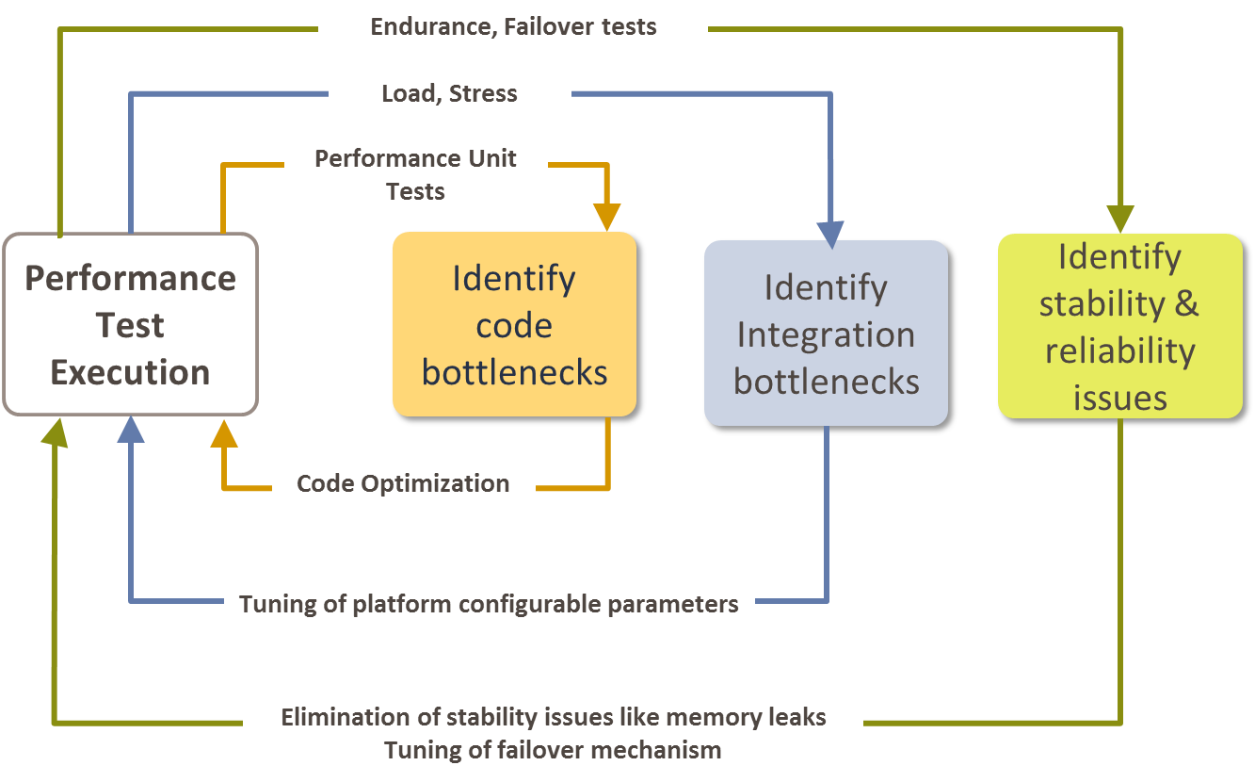
Performance Testing approach
Project Lifecycle
Performance Testing and Engineering Approach
Plan
Design
Build
Test
Deploy
Step 1 - Gather Performance Requirements - Collect and Collate all the Performance Requirements. Identify the response time, throughput and resource utilization goals
Step 2 - Plan and Design Tests – Capacity Sizing and Workload Characteristics based test Scenarios. Determine variability among test data. Define test data and establish metrics to be collected
Step 3 – Code profiling and identifying code bottlenecks. Prepare the test environment, tools and resources necessary to execute the test. Develop the performance tests in accordance with the test design
Step 4 - Run and monitor performance tests. Execute the tests with appropriate test data and test results collection. Analyze Results, consolidate and share results data.
Step 5 – Performance Monitoring and future capacity planning
Performance Requirements Definition
Performance Modeling & Architecture Optimization
Capacity Sizing
Code Profiling & Optimization
Unit Performance Testing & Tuning
Comprehensive Performance Testing & Tuning
Performance Monitoring, Health Check
Capacity Planning
Performance Engineering
Measure, Validate & Tune Performance
Manage & Sustain Performance
Review
Hardware Capacity Planning
Future Workload Characteristics
Application Logs
System configurations
Analysis of Performance Test Reports
Server resources statistics such as server response times, CPU, Memory, I/O, max concurrent users, transaction failures etc.

Slide 15
Delivery Approach
Company Confidential © Capgemini 2021. All rights reserved |
15

Slide 16
INDICATIVE STAFFING
GE Product Owner
GE Application Architect
GE Domain SME
End to End Agile POD Teams
Technical Product Manager
Scrum Master
Tech Lead
Conversion Leads
Software Engineers
Software Engineers
Software Engineers
Functional Leads
Software Engineer
Software Engineer
Software Engineer
Data Leads
Software Engineer
Software Engineer
Software Engineer
DevOps Engineers
Software Engineer
Software Engineer
Software Engineer
Engagement / Project Mgr
QA Engineers
QA Engineers
QA Engineers
Shared POD
QA Engineers
QA Engineers
QA Engineers
Collaborative Work
GE Team
Data engineers
Data engineers
Data engineers
Capgemini Team
POD 1
POD 2
POD n
* POD team roles, Skills are indicative, during Assessment the same will be updated.
Technical Product Manager

Slide 17
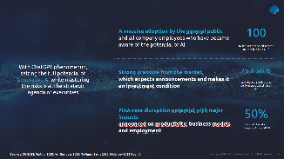


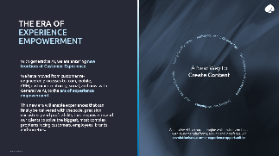
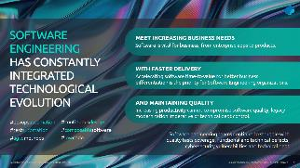


Generative AI by Capgemini Capgemini’s Broad Excellence in Generative AI
Generative AI Strategy
Custom Generative AI for Enterprise
Enables CXOs to define and prioritize the most relevant generative AI use cases for their business, demonstrate the tangible value that can be achieved, and lay the right foundations in terms of people, process and technology for scaling their generative AI investments while mitigating the risks.
Custom Generative AI for Enterprise by Capgemini is different. It’s a ring-fenced, environment that elevates and focuses on your excellence to unleash creativity through the power of technology.
With Custom Generative AI for Enterprise, we help enterprises move from a standard risked usage of generic public large models to a tailored and trusted solution based on the use of their data and their company knowledge, with reliable outputs creating significant tangible outcomes.
Generative AI for Customer Experience
Generative AI for Software Engineering
Enhances customer experience with 4 dedicated generative AI assistants.
It allows hyper-personalized customer experience with a synthetic design assistant, elevates customer self-service with personalized chatbots, augments customer care services with a content and knowledge assistant and boosts sales teams performance with a product & offers knowledge assistant.
Helps improve efficiency and quality across the whole software life cycle (from design and coding to documentation, testing, deployment, and operations), accelerate the time to market for new software, and reduce the technical debt of enterprises by facilitating large modernization programs of legacy software.
It also enables increased security with a reduced attack surface by automatically identifying bugs or vulnerabilities and proposing adjustments to software development teams.

